Slide 1
Bayesian Theory & Naïve Bayes Classifiers
Dept. of Computer Science
Faculty of Science and Technology
Lecturer No: |  | Week No: | 03 | Semester: | Summer 21-22
Instructor: | Prof. Dr. Kamruddin Nur (kamruddin@aiub.edu)

Slide 2
Bayesian Classifier
A statistical classifier: performs probabilistic prediction, i.e., predicts class membership probabilities
Foundation: Based on Bayes’ Theorem.
Performance: A basic Bayesian classifier, naïve Bayesian classifier, has comparable performance with decision tree and selected neural network classifiers
Standard: Even when Bayesian methods are computationally intractable, they can provide a standard of optimal decision making against which other methods can be measured

Slide 3
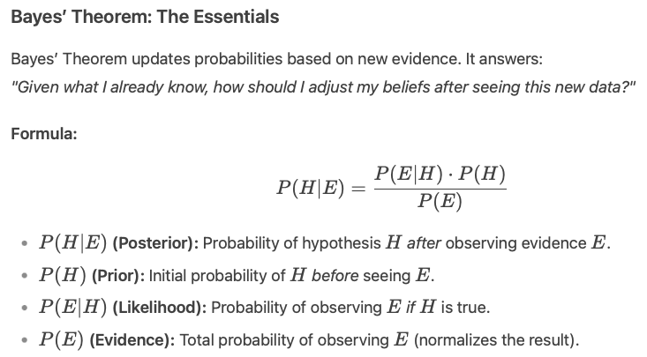
  posteriori = likelihood x prior/evidence

Slide 4
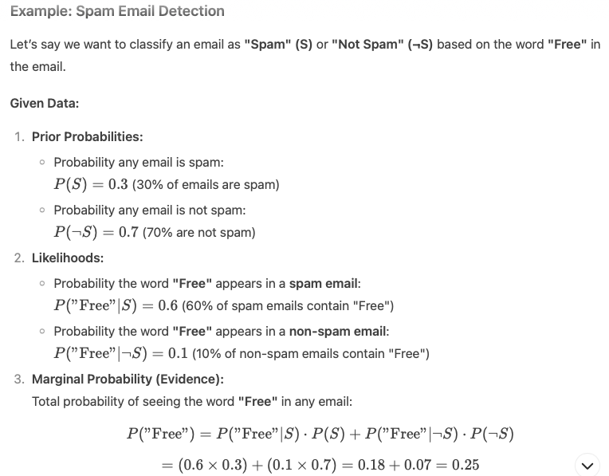

Slide 5
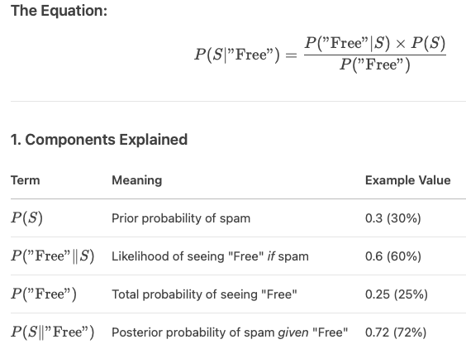
Example: Spam Email Posterior Probability
If an email contains the word "Free", what is the probability it is spam?
→ We want P(S∣"Free").

Slide 6
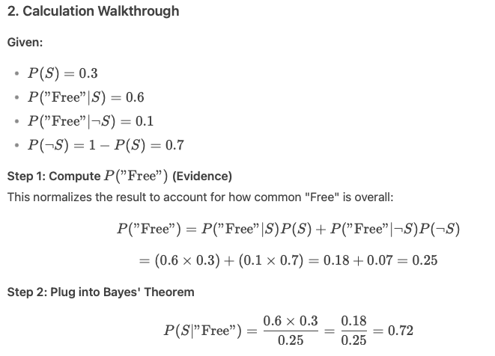
Example: Spam Email Detection
Interpretation:
Even though only 30% of all emails are spam, the presence of the word "Free" raises the probability to 72% that this email is spam.

Slide 7
  posteriori = likelihood x prior/evidence

Slide 8
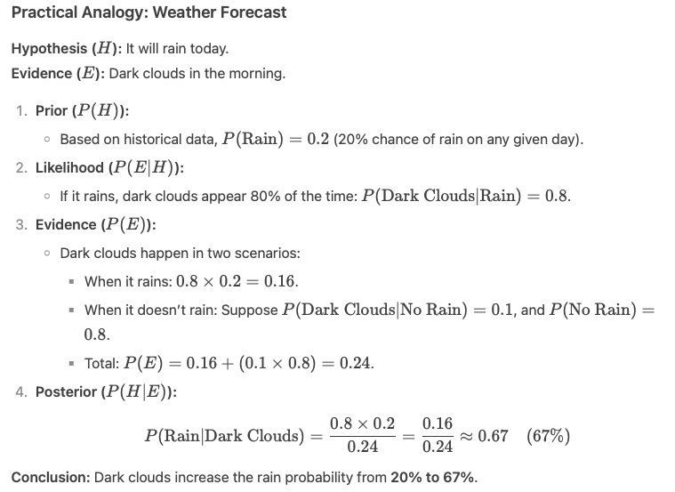

Slide 9
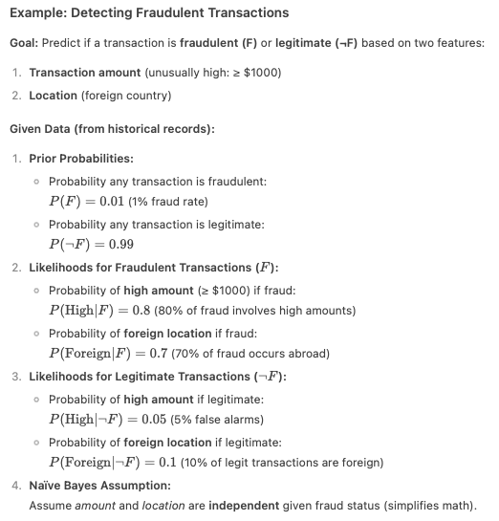

Slide 10
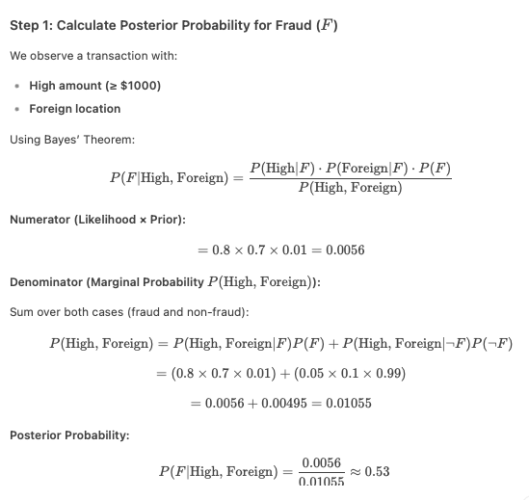

Slide 11
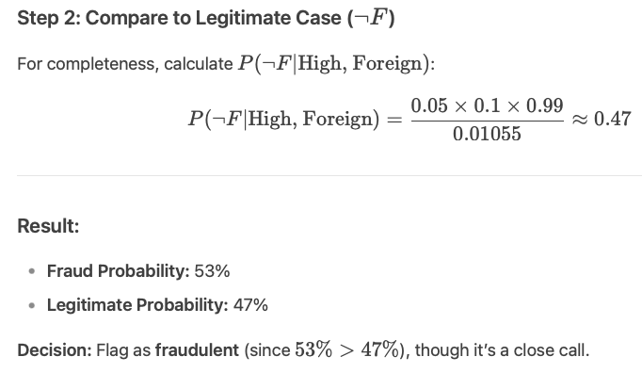

Slide 12
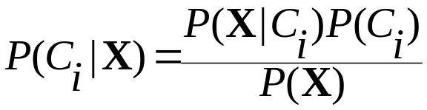

Classification Is to Derive the Maximum Posteriori
Let D be a training set of tuples and their associated class labels, and each tuple is represented by an n-D attribute vector X = (x₁, x₂, …, x_{n})
Suppose there are m classes C₁, C₂, …, C_{m}.
Classification is to derive the maximum posteriori, i.e., the maximal P(C_{i}|X)
This can be derived from Bayes’ theorem
Since P(X) is constant for all classes, only
  needs to be maximized

Slide 13
Does patient have cancer or not?
A patient takes a lab test and the result comes back positive. It is known that the test returns a correct positive result in only 99% of the cases and a correct negative result in only 95% of the cases. Furthermore, only 0.03 of the entire population has this disease.
  1. What is the probability that this patient has cancer?
  2. What is the probability that he does not have cancer?
  3. What is the diagnosis?

Slide 14

Applying Bayes’ rule:
A basic Example
The conditional probability P(effect | cause) quantifies the relationship in the causal direction,
whereas P(cause | effect) describes the diagnostic direction
In a task such as medical diagnosis, we often have conditional probabilities on causal relationships (that is, the doctor knows P(symptoms | disease)) and want to derive a diagnosis, P(disease | symptoms).

Slide 15
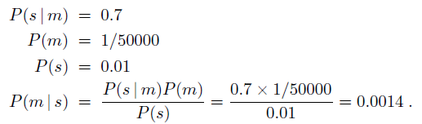
Applying Bayes’ rule:
A basic Example
A doctor knows that the disease meningitis causes the patient to have a stiff neck, say, 70% of the time. The doctor also knows some unconditional facts: the prior probability
that a patient has meningitis is 1/50,000, and the prior probability that any patient has a stiff neck is 1%.
Letting
s be the proposition that the patient has a stiff neck and
m be the proposition that the patient has meningitis, we have

Slide 16
Bayesian Methods
Learning and classification methods based on probability theory.
Bayes theorem plays a critical role in probabilistic learning and classification.
Uses prior probability of each category given no information about an item.
Categorization produces a posterior probability distribution over the possible categories given a description of an item.

Slide 17
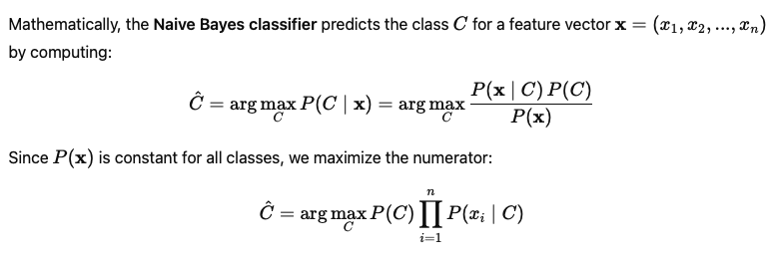
Bayes classifier
Naive Bayes classifier is a probabilistic machine learning model based on Bayes' Theorem that assumes all features are independent given the class label (the "naive" part). It calculates the probability of a data point belonging to each class and picks the class with the highest probability. It’s fast, simple, and works well especially for text classification like spam detection.

Slide 18
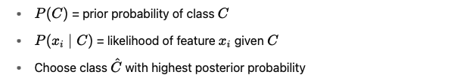
Naive Bayes classifier

Slide 19
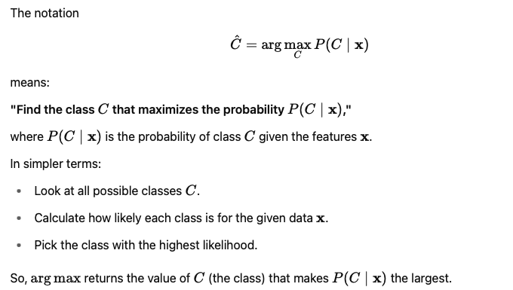
Naive Bayes classifier (cont’d)

Slide 20
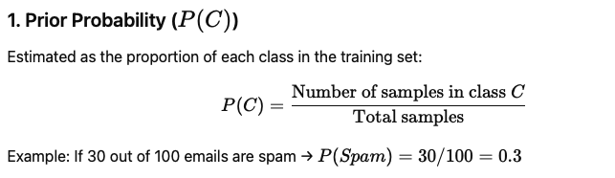
Parameter Estimation in Naive Bayes
In Naive Bayes classifier, parameter estimation means calculating the probabilities required for classification from the training data:

Slide 21
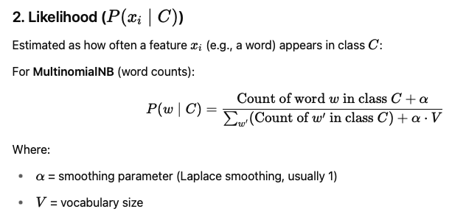
Parameter Estimation in Naive Bayes

Slide 22
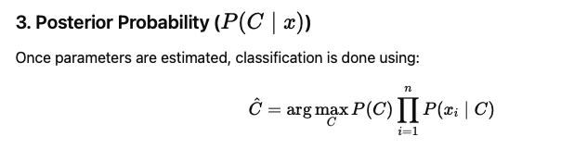
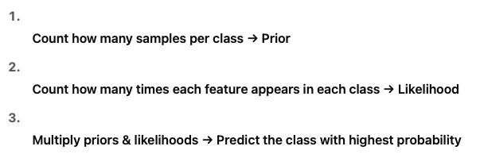
Parameter Estimation in Naive Bayes

Slide 23
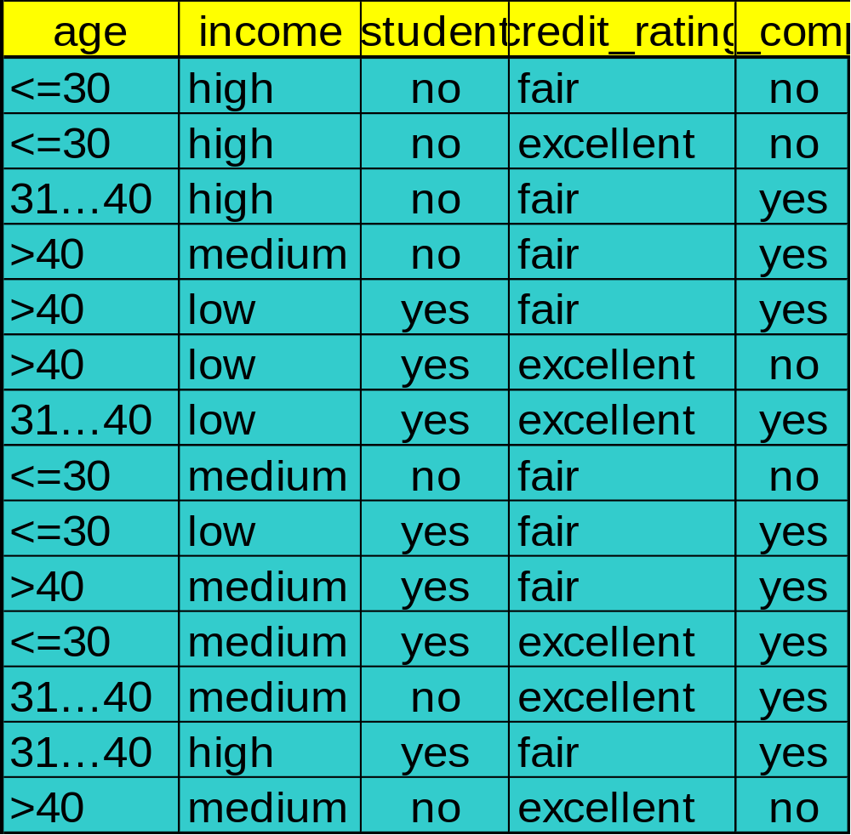
Naïve Bayes Classifier: Training Dataset
Class:
C1:buys_computer = ‘yes’
C2:buys_computer = ‘no’
Data to be classified:
X = (age <=30,
Income = medium,
Student = yes
Credit_rating = Fair)

Slide 24
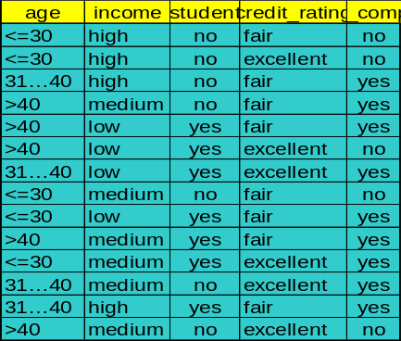
Naïve Bayes Classifier: Computer Purchase
P(C_{i}): P(buys_computer = “yes”) = 9/14 = 0.643
P(buys_computer = “no”) = 5/14= 0.357
Compute P(X|C_{i}) for each class
  P(age = “<=30” | buys_computer = “yes”) = 2/9 = 0.222
  P(age = “<= 30” | buys_computer = “no”) = 3/5 = 0.6
  P(income = “medium” | buys_computer = “yes”) = 4/9 = 0.444
  P(income = “medium” | buys_computer = “no”) = 2/5 = 0.4
  P(student = “yes” | buys_computer = “yes) = 6/9 = 0.667
  P(student = “yes” | buys_computer = “no”) = 1/5 = 0.2
  P(credit_rating = “fair” | buys_computer = “yes”) = 6/9 = 0.667
  P(credit_rating = “fair” | buys_computer = “no”) = 2/5 = 0.4
X = (age <= 30 , income = medium, student = yes, credit_rating = fair)
P(X|C_{i}) : P(X|buys_computer = “yes”) = 0.222 x 0.444 x 0.667 x 0.667 = 0.044
P(X|buys_computer = “no”) = 0.6 x 0.4 x 0.2 x 0.4 = 0.019
P(X|C_{i})*P(C_{i}) : P(X|buys_computer = “yes”) * P(buys_computer = “yes”) = 0.028
P(X|buys_computer = “no”) * P(buys_computer = “no”) = 0.007
Therefore, X belongs to class (“buys_computer = yes”)

Slide 25

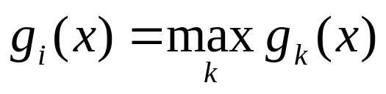
What is discriminant Function
For classification problem, for each class, define a function such that we choose Ci if

Slide 26
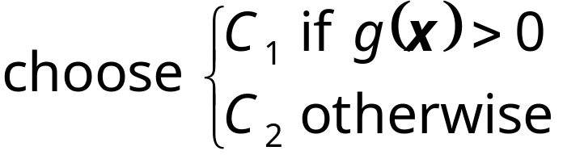
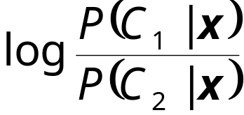
K=2 Classes
Dichotomizer (K=2) vs Polychotomizer (K>2)
g(x) = g₁(x) – g₂(x)
Log odds:

Slide 27


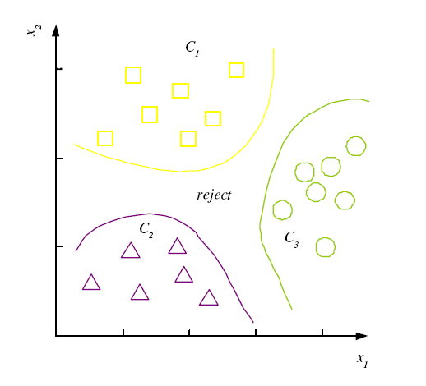
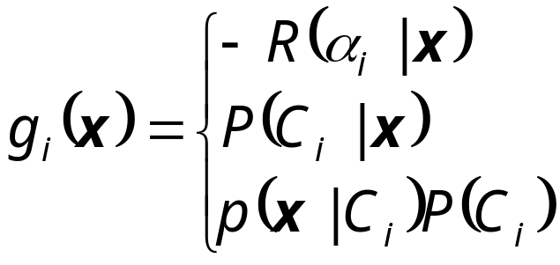

Discriminant Functions
K decision regions R₁,...,R_{K}

Slide 28


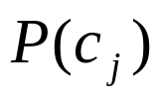
Properties
Estimating instead of greatly reduces the number of parameters (and the data sparseness).
The learning step in Naïve Bayes consists of estimating and based on the frequencies in the training data
An unseen instance is classified by computing the class that maximizes the posterior
When conditioned independence is satisfied, Naïve Bayes corresponds to MAP classification.

Slide 29
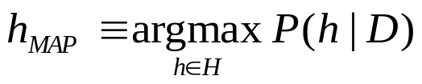
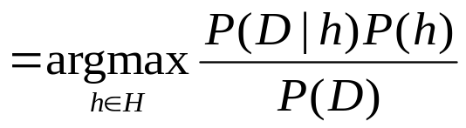
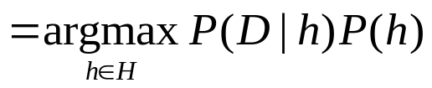
Maximum A Posterior
Based on Bayes Theorem, we can compute the Maximum A Posterior (MAP) hypothesis for the data
We are interested in the best hypothesis for some space H given observed training data D.
H: set of all hypothesis.
Note that we can drop P(D) as the probability of the data is constant (and independent of the hypothesis).

Slide 30
Desirable Properties of Bayes Classifier
Incrementality: with each training example, the prior and the likelihood can be updated dynamically: flexible and robust to errors.
Combines prior knowledge and observed data: prior probability of a hypothesis multiplied with probability of the hypothesis given the training data
Probabilistic hypothesis: outputs not only a classification, but a probability distribution over all classes

Slide 31
Naïve Bayes Classifier: Comments
Advantages
  Easy to implement
  Good results obtained in most of the cases
Disadvantages
  Assumption: class conditional independence, therefore loss of accuracy
  Practically, dependencies exist among variables
    E.g., hospitals: patients: Profile: age, family history, etc.
      Symptoms: fever, cough etc., Disease: lung cancer, diabetes, etc.
    Dependencies among these cannot be modeled by Naïve Bayes Classifier

Slide 32
Project Proposal Submission Instructions
Submit hard copy of project proposal in the class time. One copy for one group.
A short presentation (5-7 minutes) on the proposal to explain what has to be done. One person is fine to present, but all members must attend in the Q&N session.

Slide 33
Textbook/ Reference Materials
Introduction to Machine Learning by Ethem Alpaydin
Machine Learning: An Algorithmic Perspective by Stephen Marsland
Pattern Recognition and Machine Learning by Christopher M. Bishop

